Slide 1
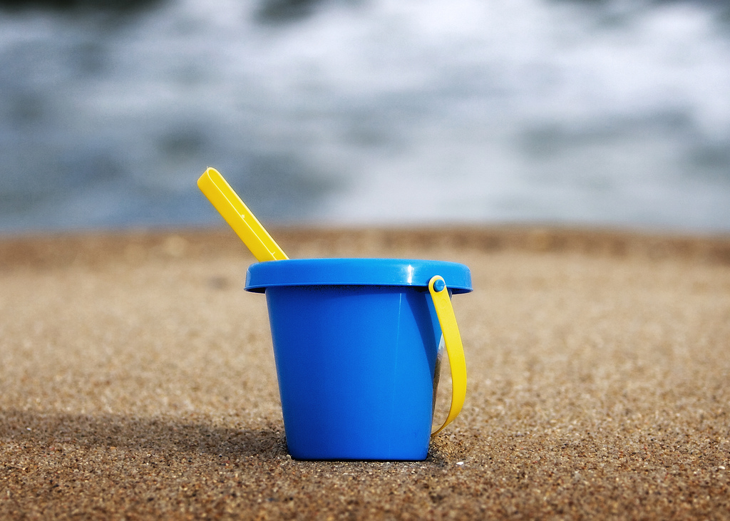
The
Bucket List

Slide 2
Today’s Plan
Warm Up Game (Scene It)
Review Google Worksheet
Bucket List

Slide 3
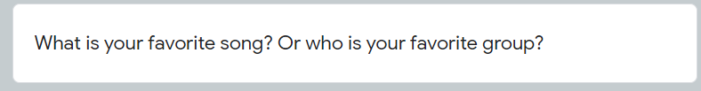


Slide 4
Favorite Memory
Answers that I liked
I liked everyone’s answers though!

Slide 5
There are no good memories because of Corona
Many students said this way and I understand but let’s think positively! (it is easy to say but hard to do though)

Slide 6
My favorite memory from 2020 is video call with friends.
My favorite memory from 2020 is video chatting (calling) with my friends.

Slide 7
When I played Minecraft with my sister.

Slide 8
My favorite memory in 2020 was dying my hair.

Slide 9
I went to see the sea with my family.

Slide 10
New Year’s Resolutions

Slide 11
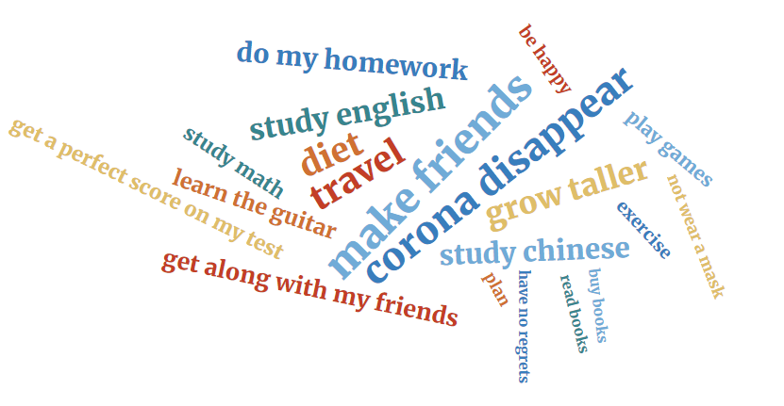

Slide 12
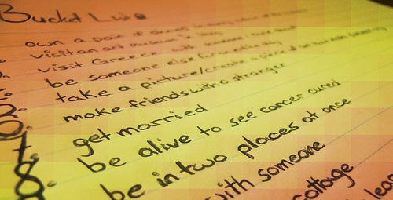
What is a Bucket List?
A list of things you want to do before you die

Slide 13
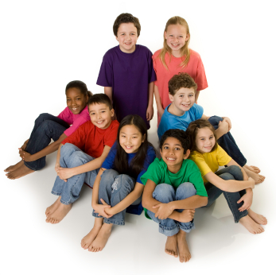
Anybody can make a bucket list
You are about to start a new life adventure so it is a great chance to think about future dreams!

Slide 14
I want to …
I hope to
I wish to
I will
I dream to
Let’s look at some famous/popular bucket list items.

Slide 15

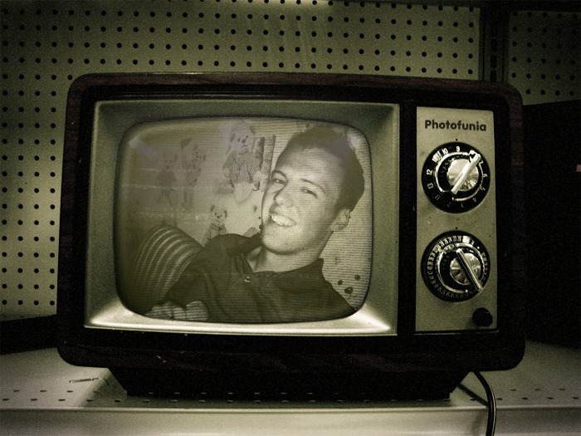
1. I want to… be on TV

Slide 16
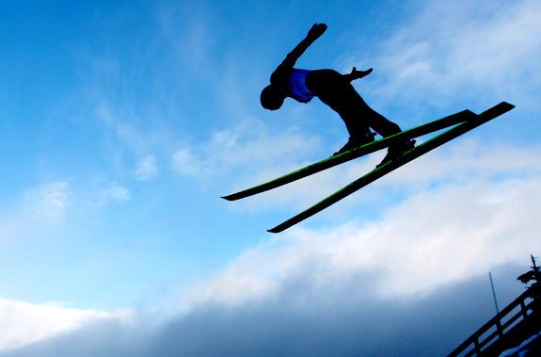
2. I want to... be an athlete

Slide 17
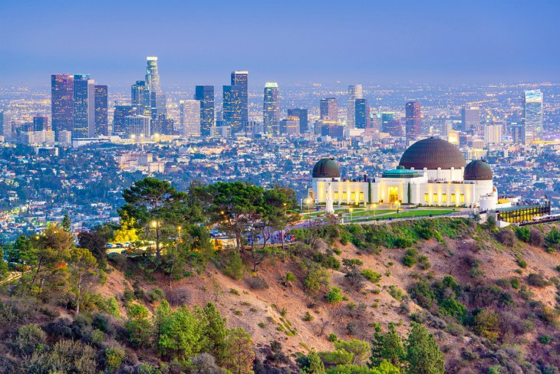
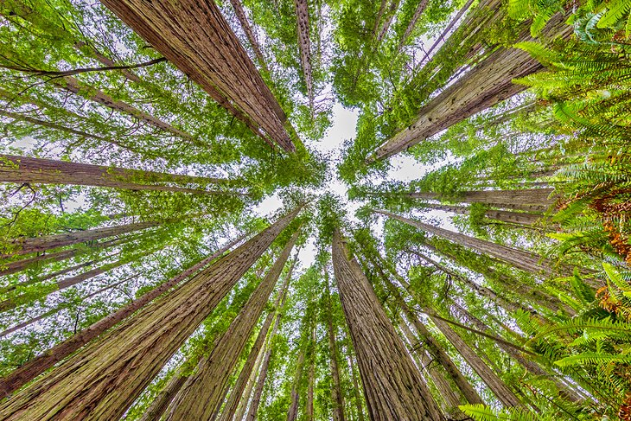
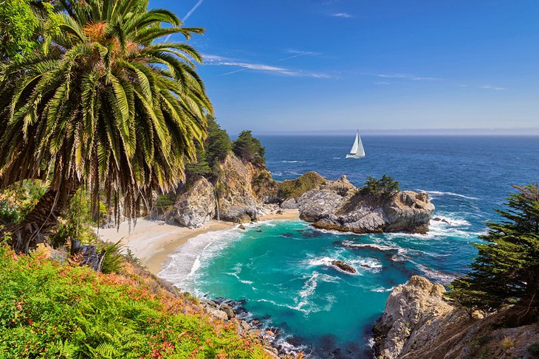
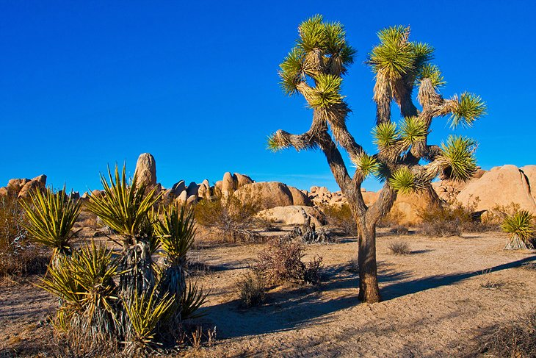
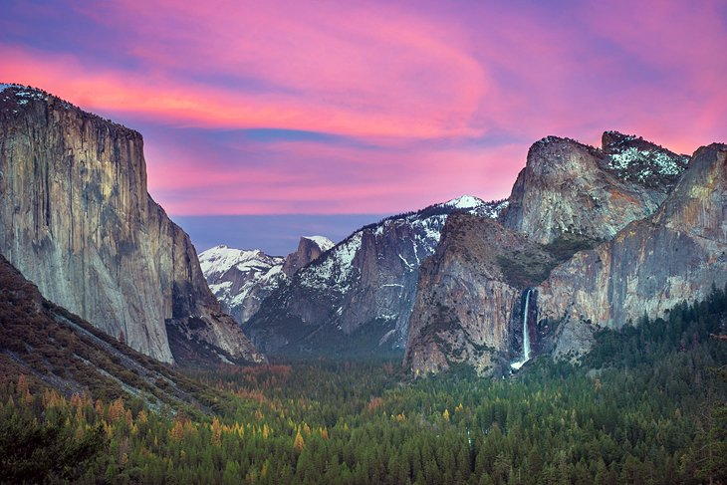
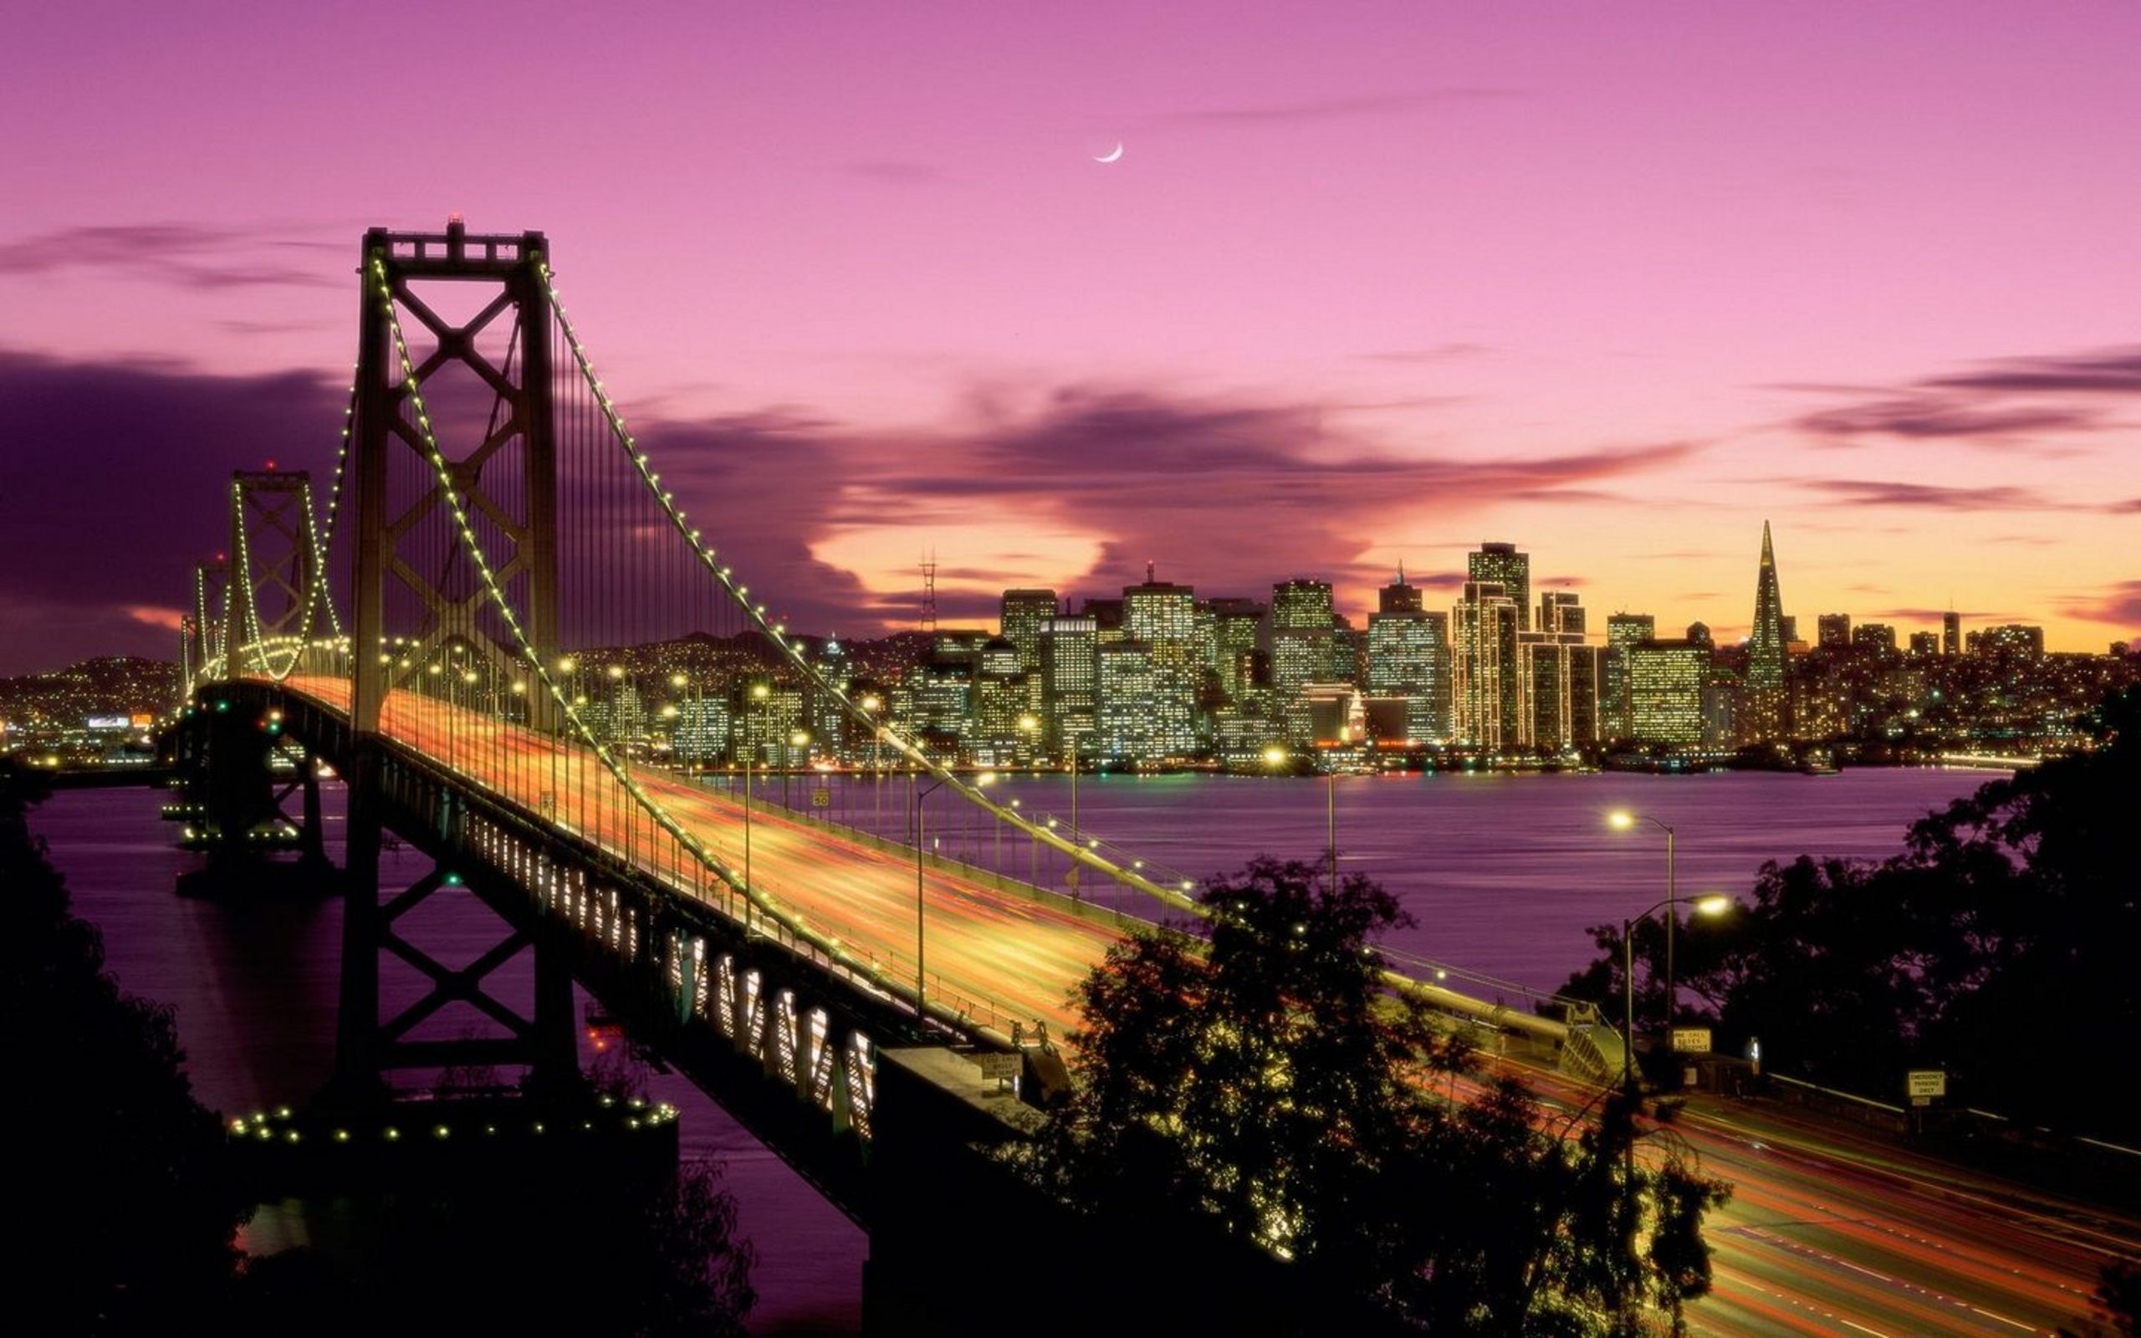
3. I want to... see California

Slide 18
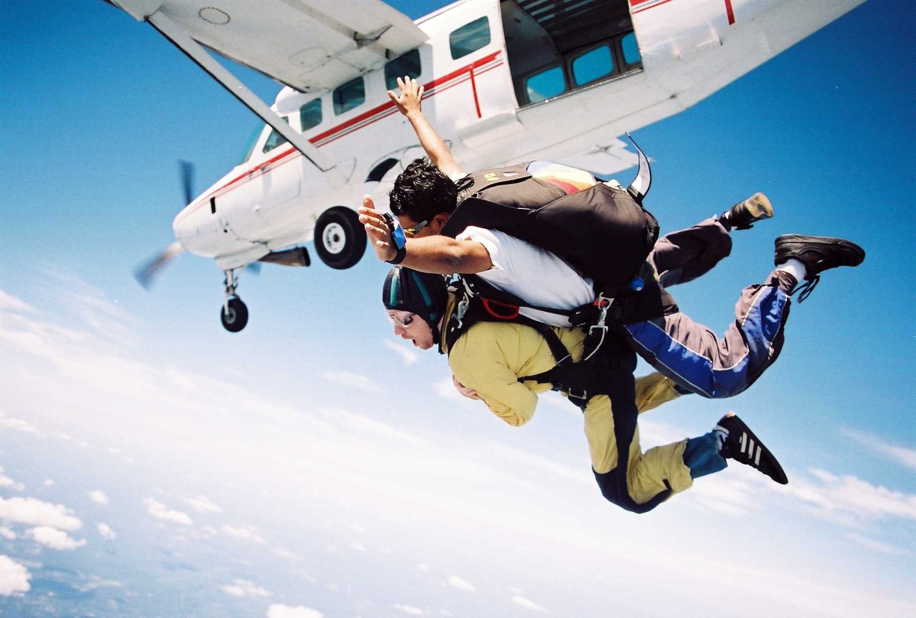
4. I want to… skydive

Slide 19
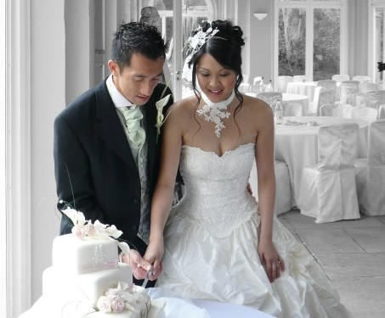
5. I want to… get married

Slide 20

6. I want to... go to university

Slide 21
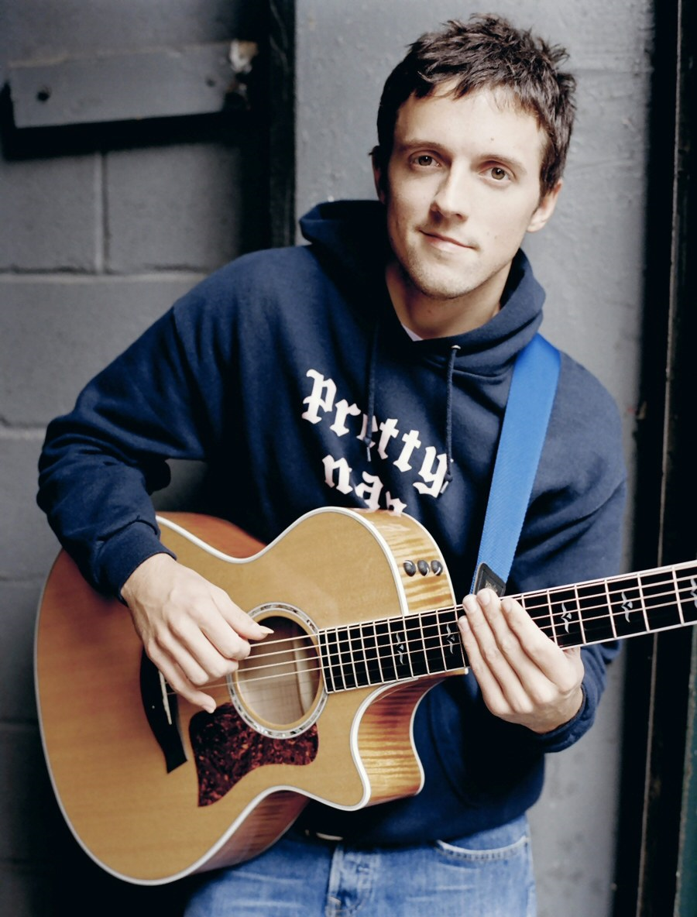
7. I want to... learn an instrument

Slide 22
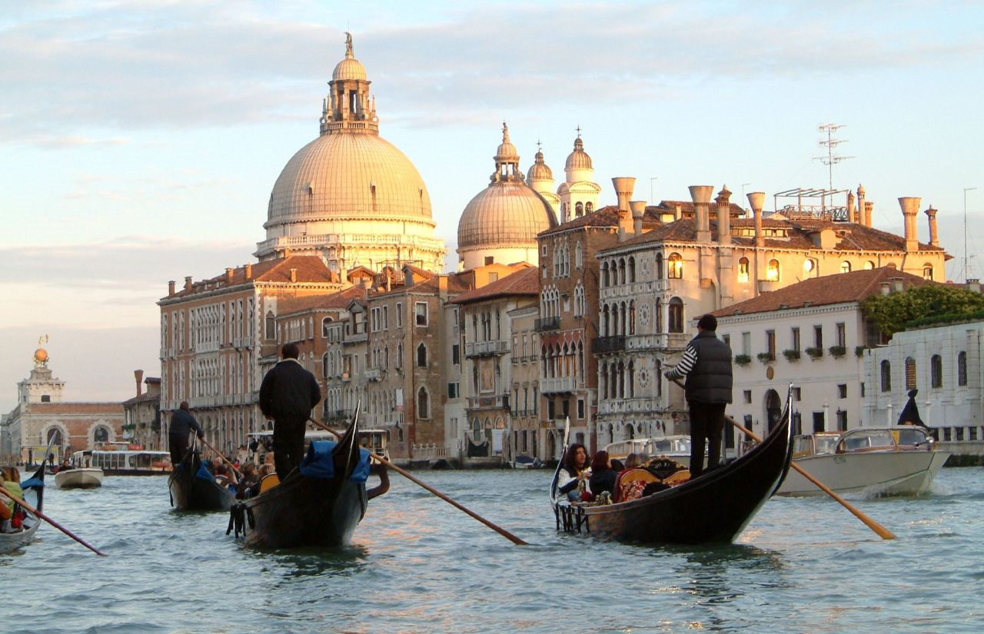
8. I want to... visit Venice

Slide 23
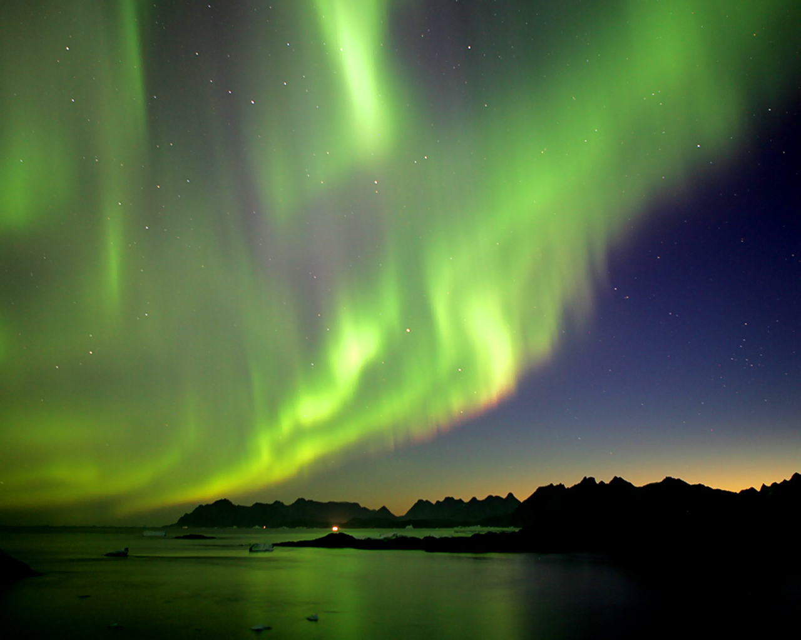
9. I want to... see the northern lights

Slide 24
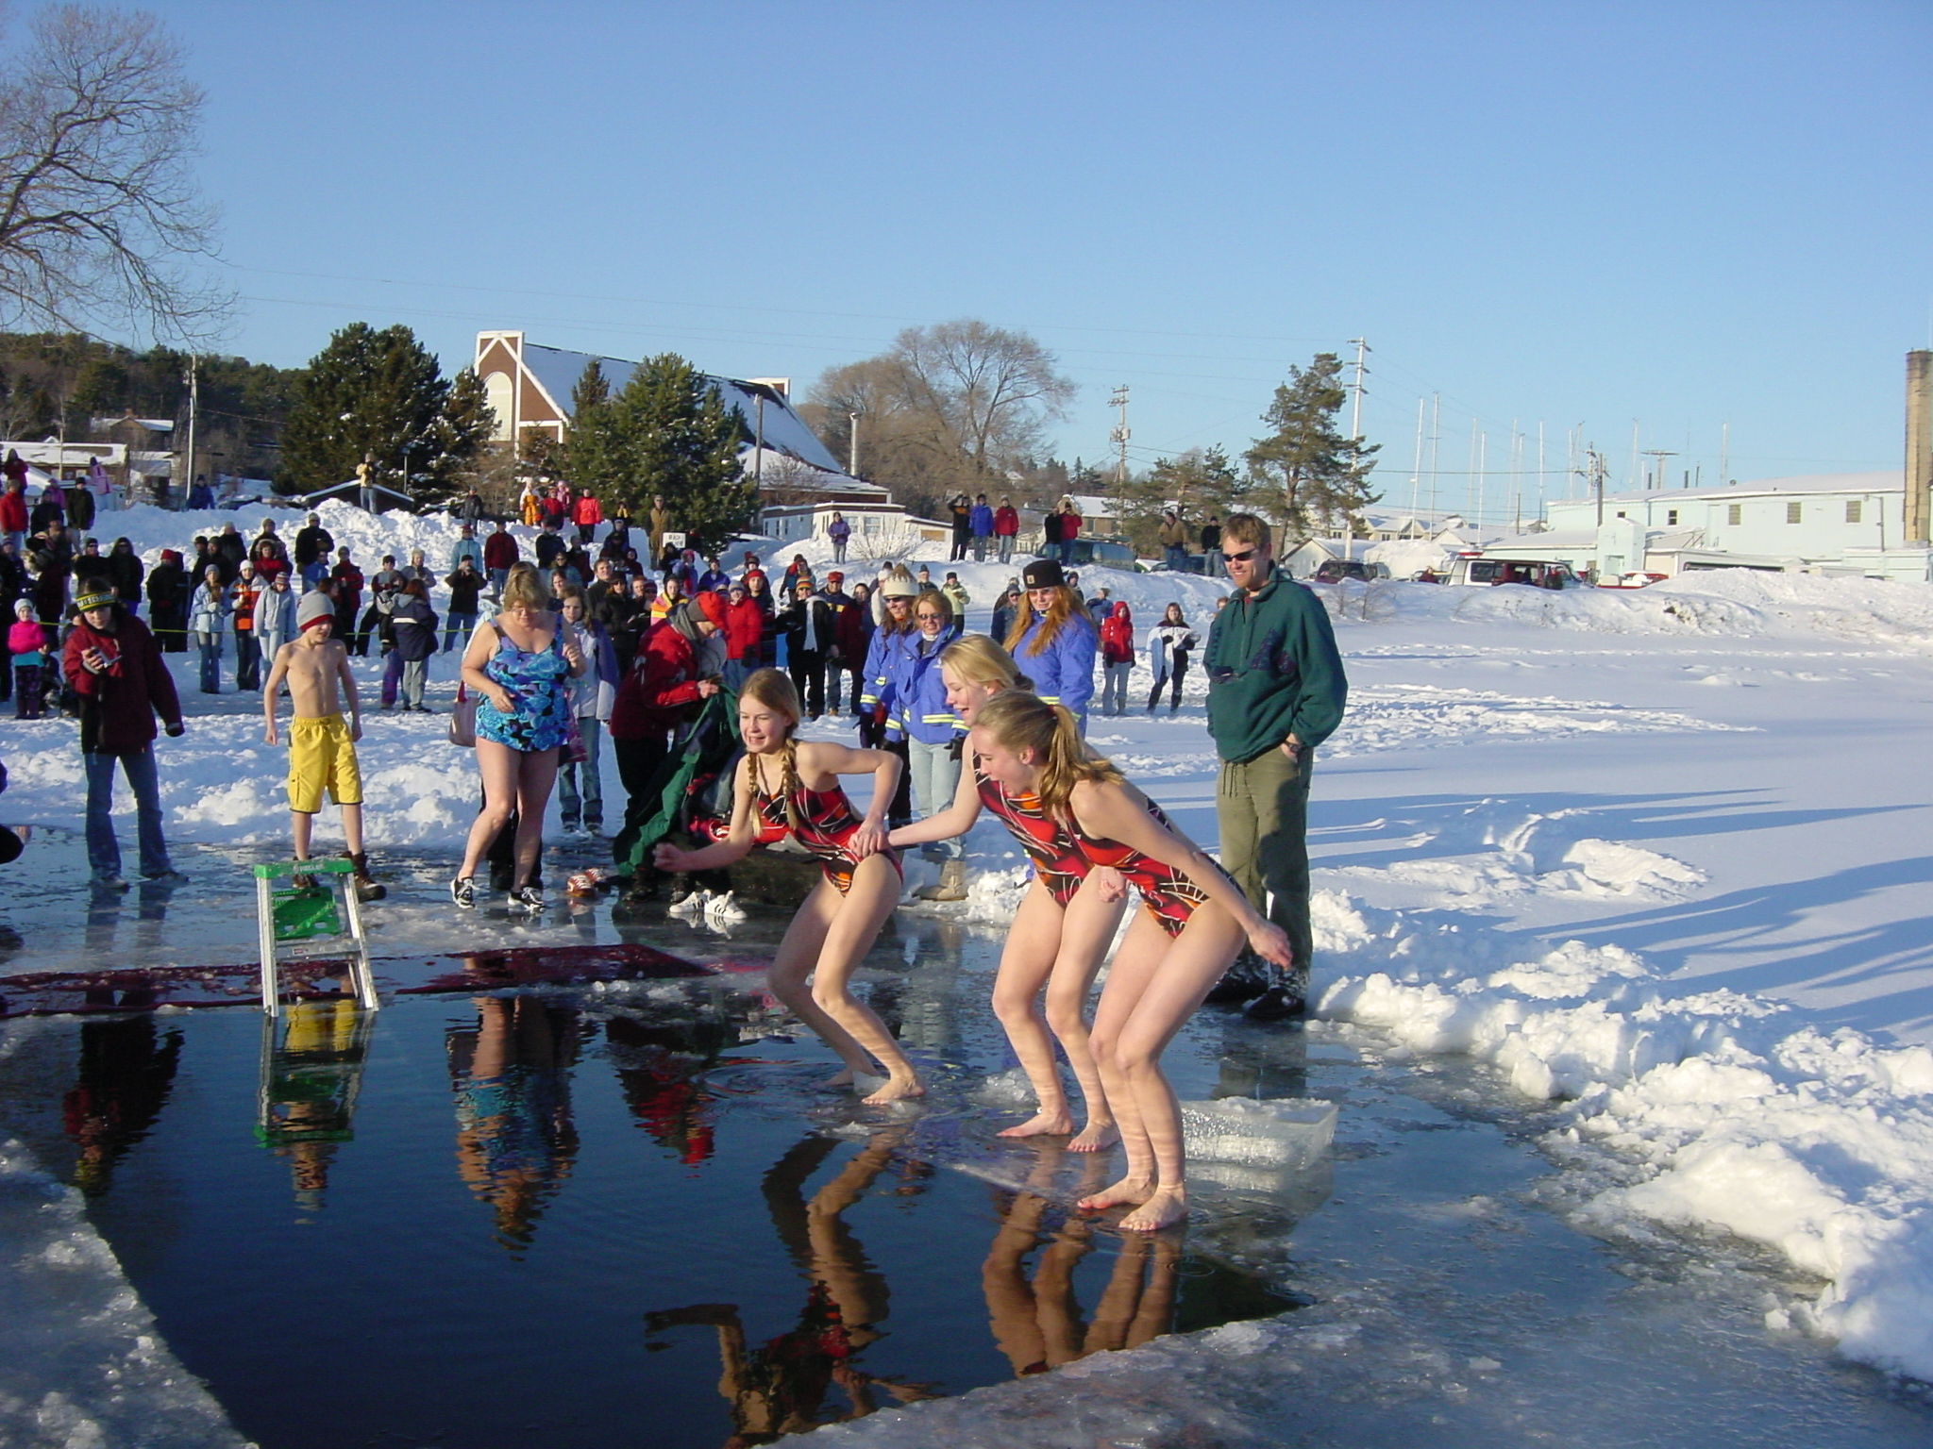
10. I want to... do a polar swim

Slide 25
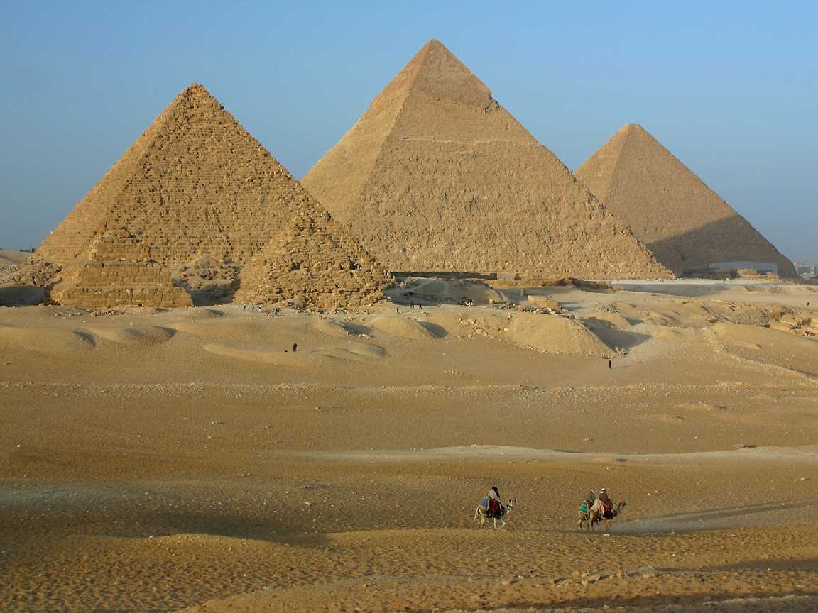
11. I want to... see the Pyramids

Slide 26
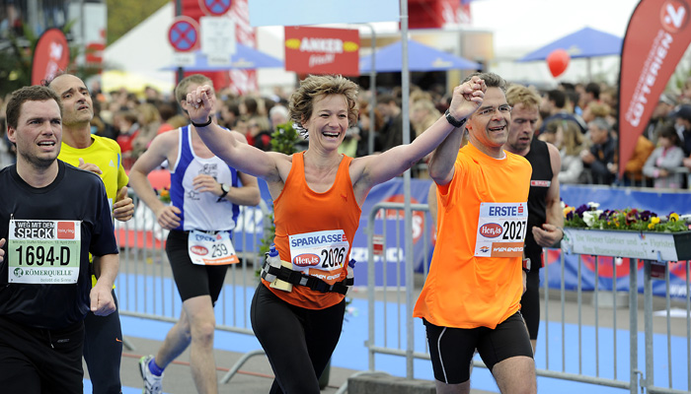
12. I want to... run a marathon

Slide 27
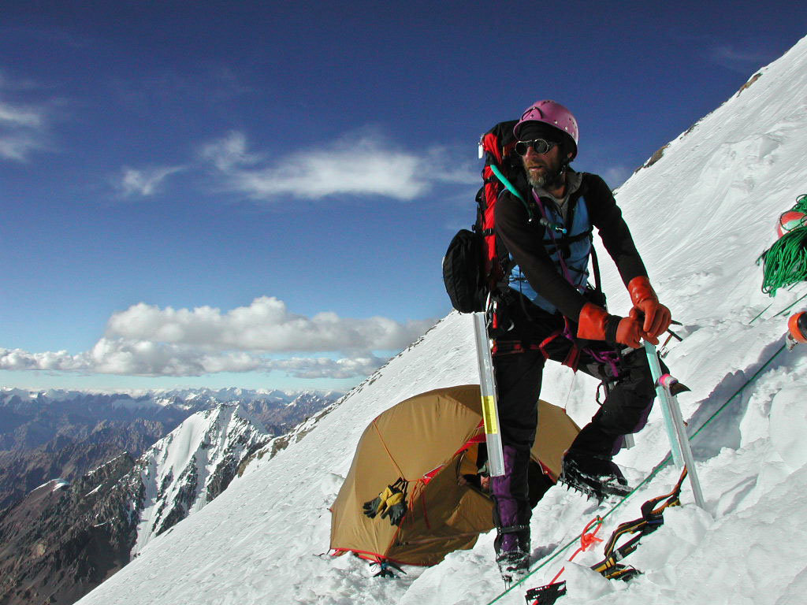
13. I want to... climb Mt. Everest

Slide 28
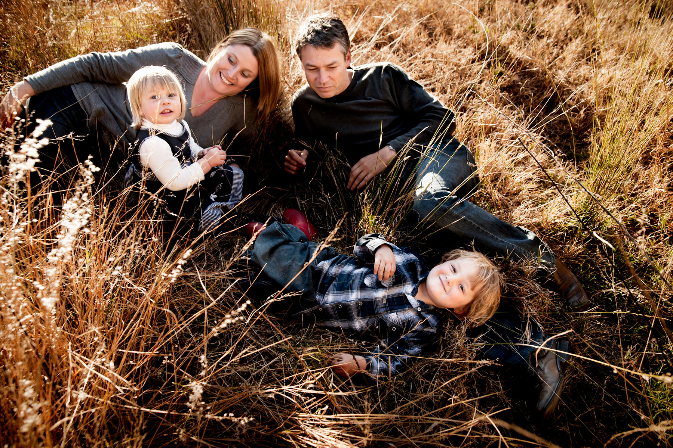
14. I want to... have kids

Slide 29
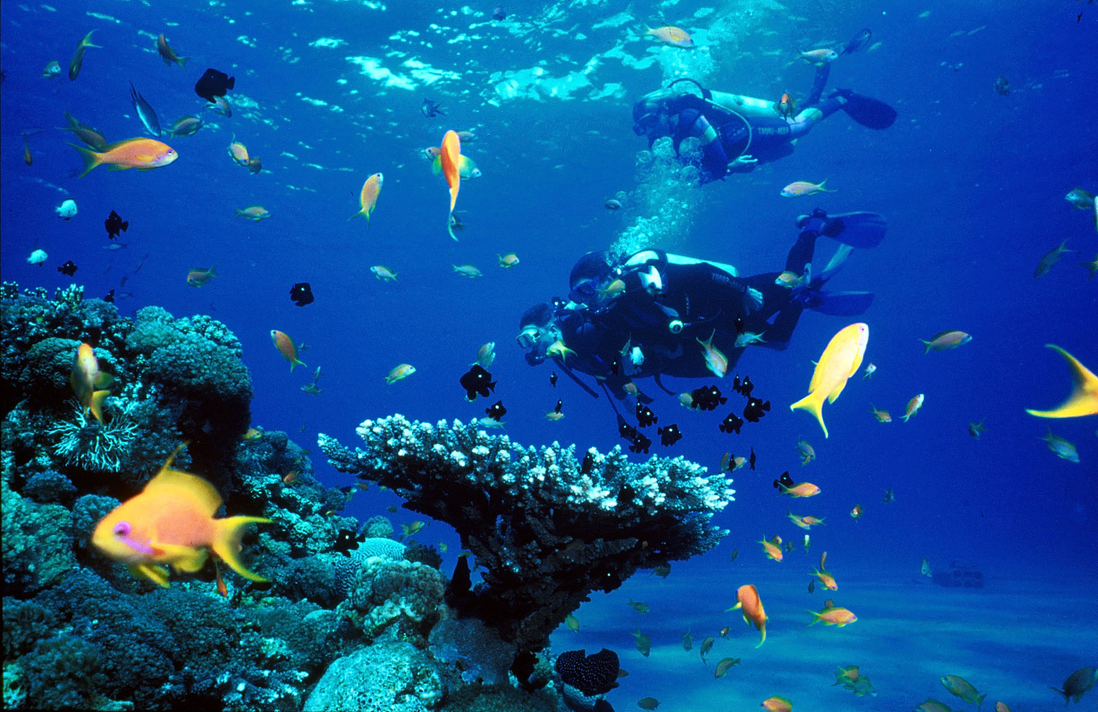
15. I want to... learn to scuba dive

Slide 30
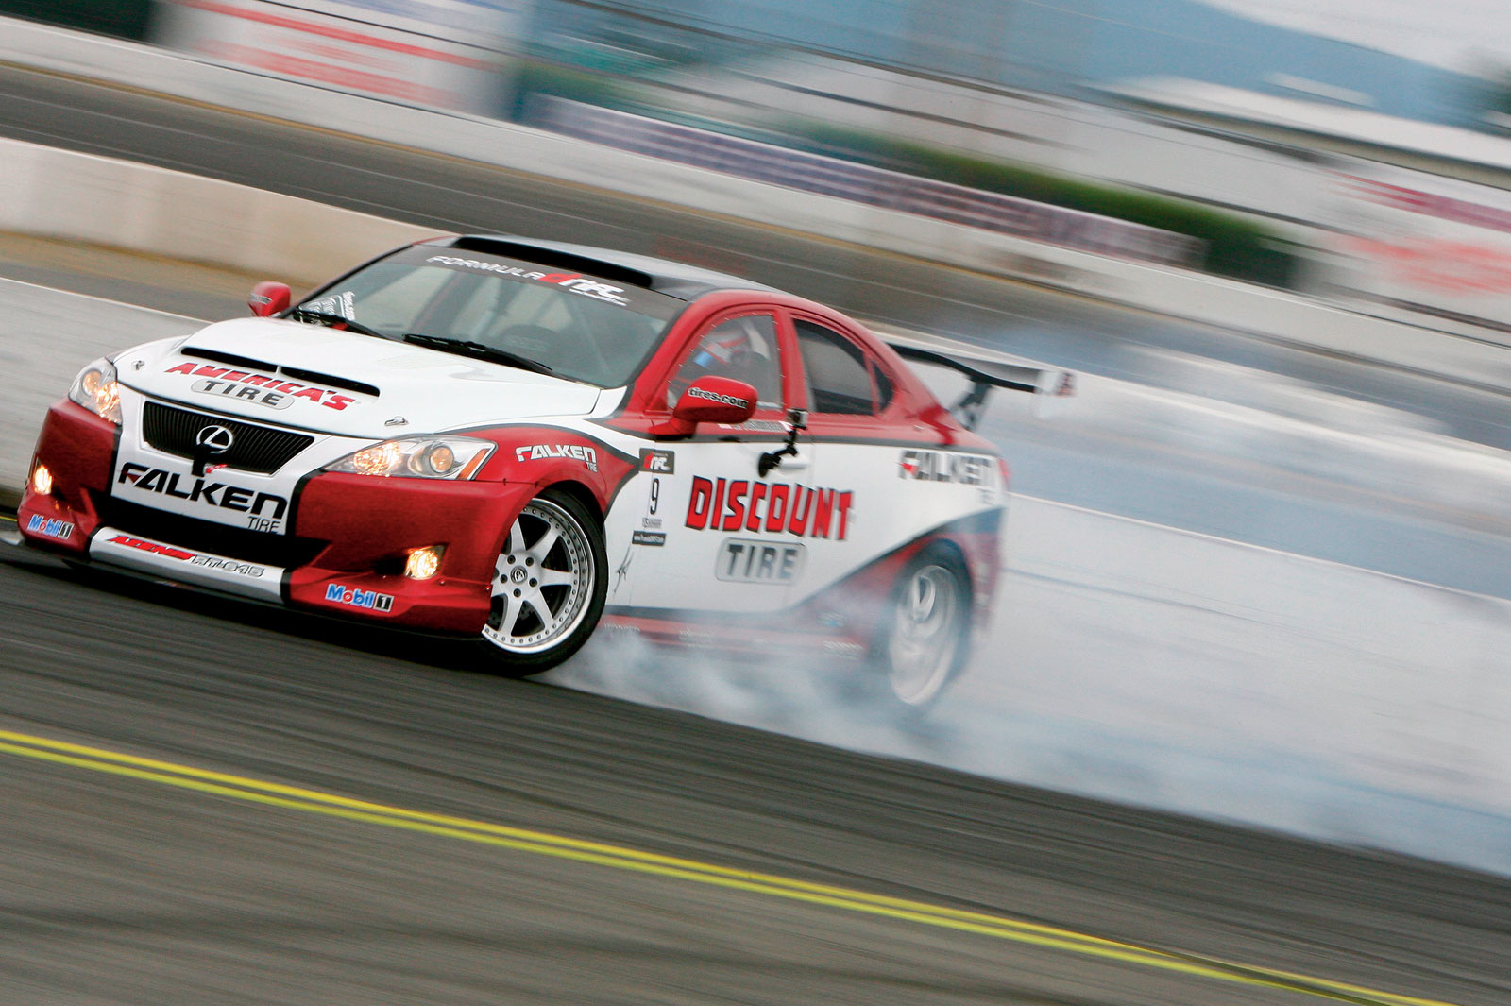
16. I want to... drive a race car

Slide 31
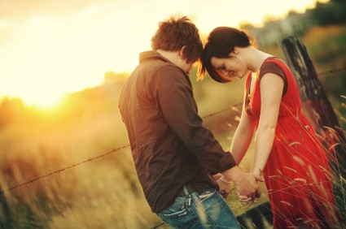
17. I want to... fall in love

Slide 32

It’s never too early to dream. Write at least 5 things YOU want to do before you kick the bucket.

Slide 33
My Bucket List

Slide 34
I want to drive across America with my family.
In 2011, I drove across America with my best friend. It was a great trip but I want to try again with my wife and daughter.

Slide 35
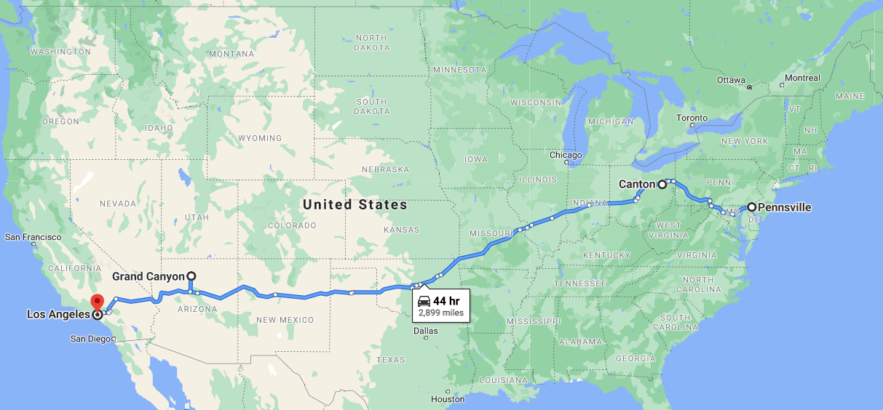
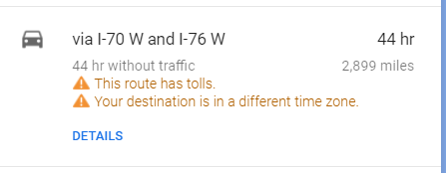
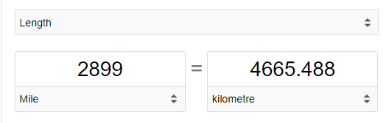

Slide 36
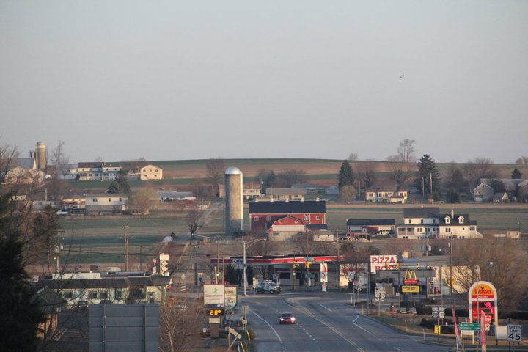
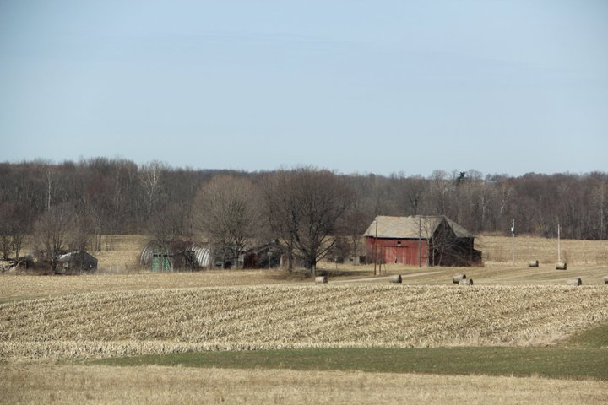
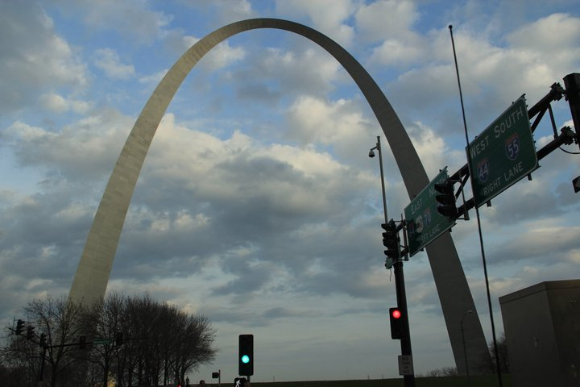
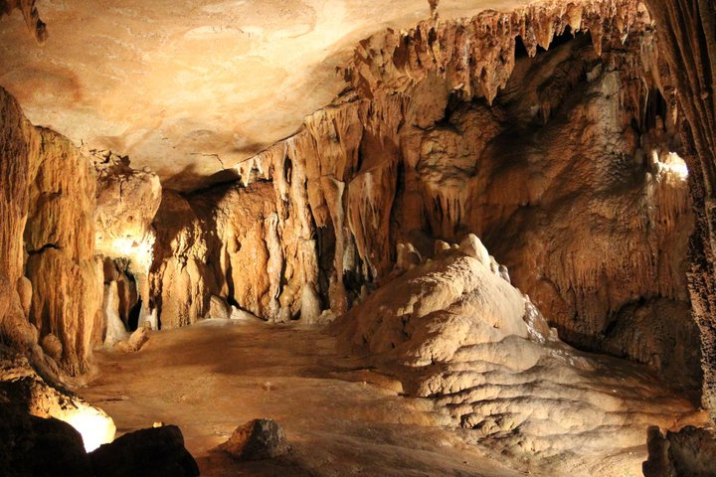

Slide 37
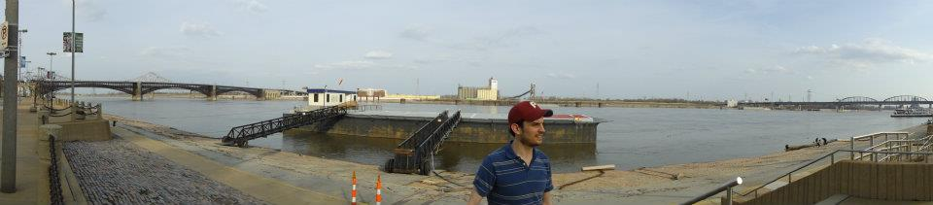
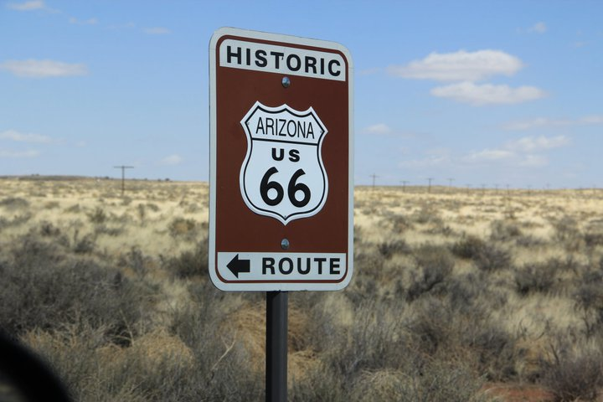
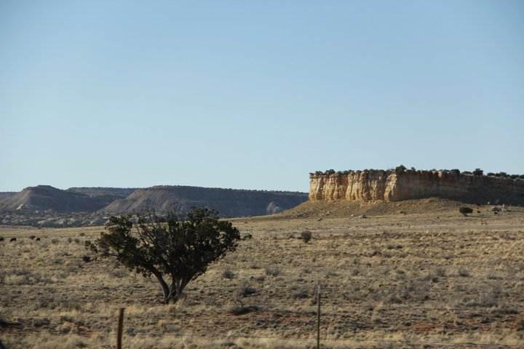

Slide 38
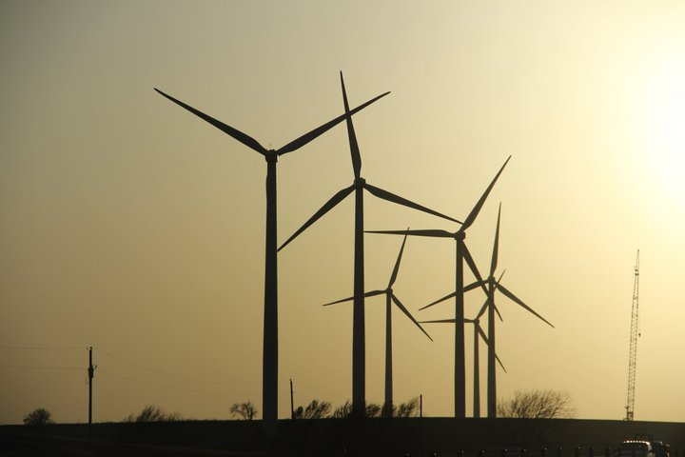
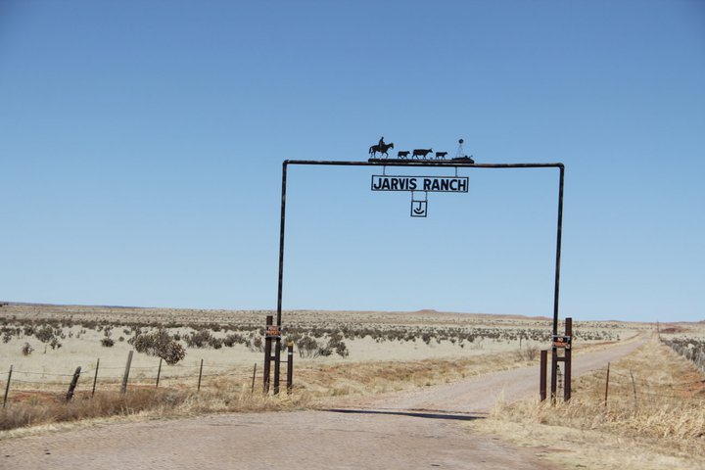
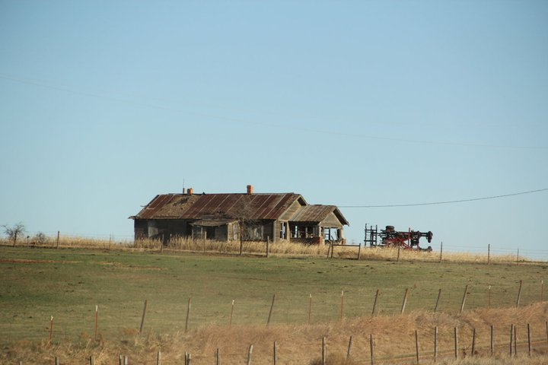
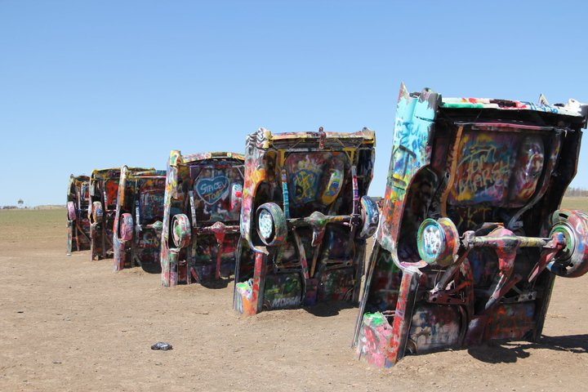

Slide 39
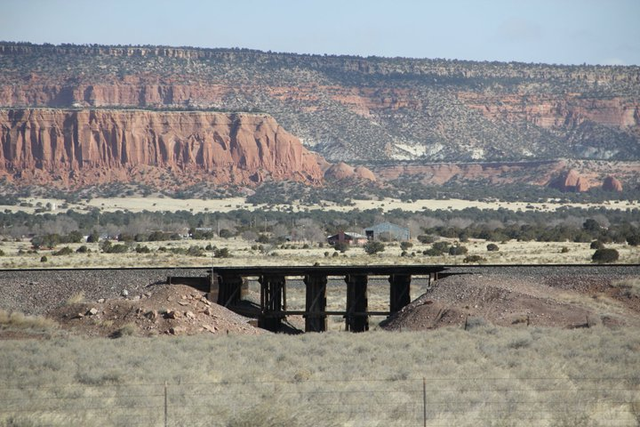
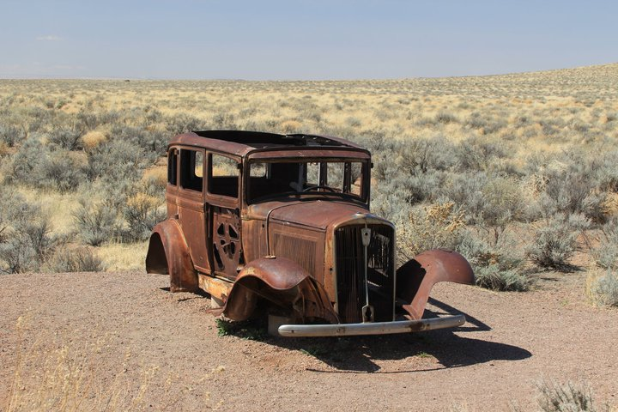
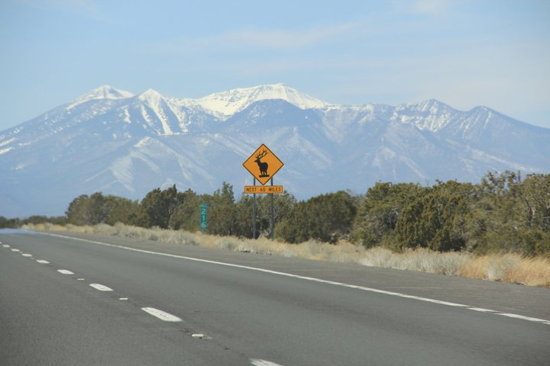

Slide 40
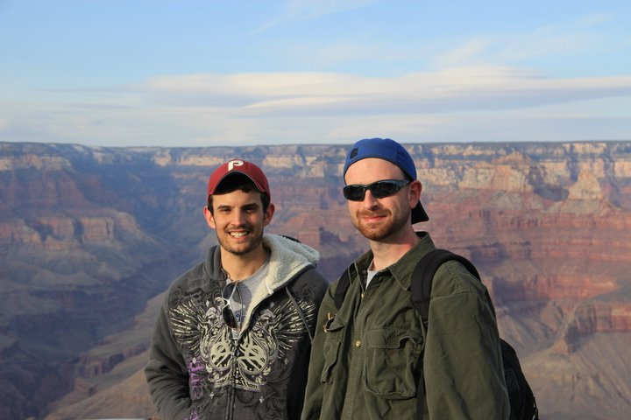
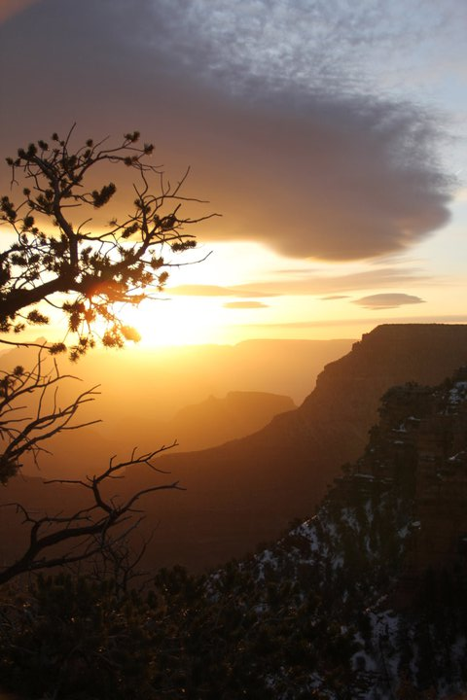
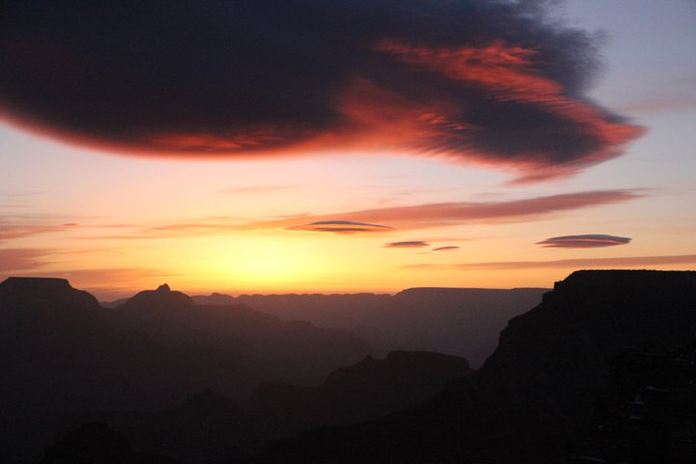
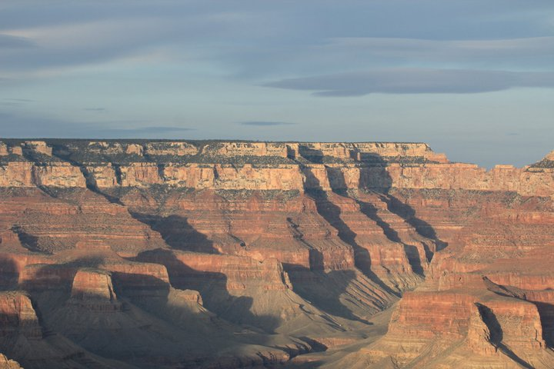

Slide 41
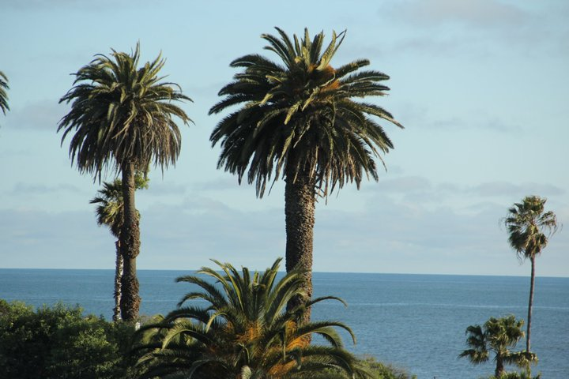
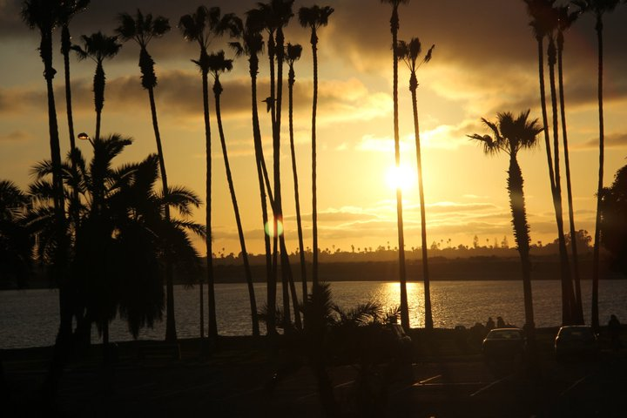
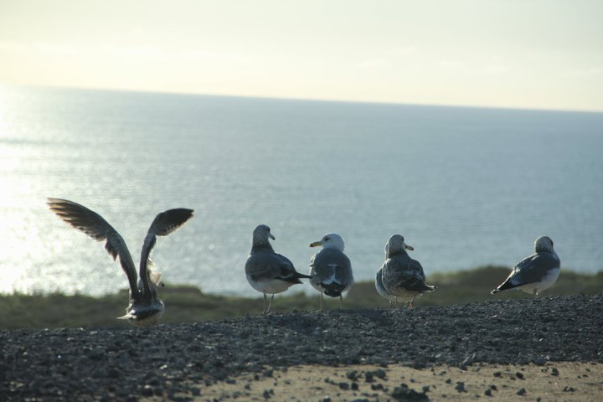


Slide 42

I want to live in America for a few years.
I would love to live in Oregon.

Slide 43
I want to write an album
When I was younger I wrote lots of music. I don’t have a lot of time to write music but one day I want to try.

Slide 44

I want to buy a house.
I love my apartment but I like living in a house.

Slide 45

I want to learn the piano
I have always thought the piano was a beautiful instrument.

Slide 46

For our homework
Tell me five things
Drive across America with my family.
Live in America Again (For a little bit)
Write an album
Buy a house
Learn the Piano

Slide 47
Final Thoughts
In case I don’t see you again.

Slide 48
Thoughts on English
Although it might not be important, you will be happier that you tried to learn.
Speaking and writing is very important
Don’t forget this!
Practice speaking even with friends.

Slide 49
Thoughts on School
Studying is hard and boring but it is important.
You will not be sad that you studied.
It is like exercise
You don’t want to do it.
You hate doing it
But when you are done, you look and feel good
In the end you will be healthier because of it.

Slide 50
Thoughts on growing up
Don’t be afraid of mistakes.
Reading is cool
Remember your friends
Try new things and meet new people
Be kind

